Slide 1

Can we predict if New Users will book or not and which country?
Team “The Aggregators”:
Dee
Juan
Zineb
Tanique
Notes:
Dee -
Intro –
+ Greetings/Names
+ Project Topic

Slide 2




Project Layout
Overview
Datasets
Data Cleaning
Visualizations
Models
Results & Learnings
Notes:
Dee -
Project Layout

Slide 3
Overview
Problem Statement: Can we predict if a New Airbnb User will book and which country?
Data Source: Kaggle.com
Tools Utilized: Python, Tableau, Pandas, Matplotlib, Seaborn
Model Utilized: Logistic Regression
Notes:
Dee -

Slide 4
DATASETS
Notes:
Dee -

Slide 5
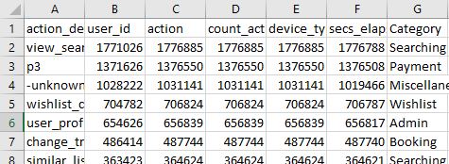
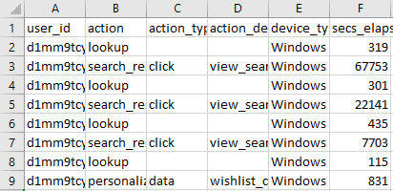
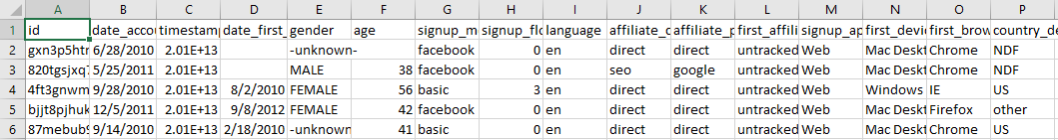
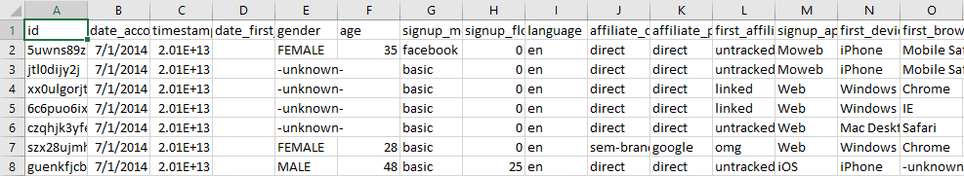
User Session Data
Demographic Data
Train and Test Data
Notes:
Dee

Slide 6
DATA CLEANING

Slide 7
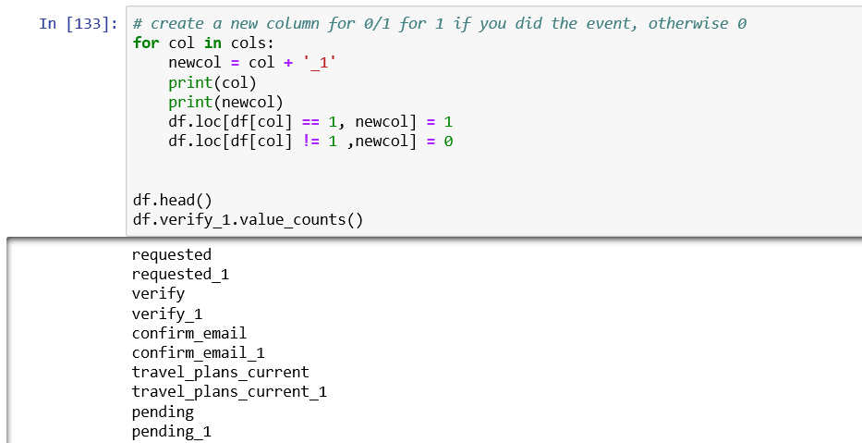
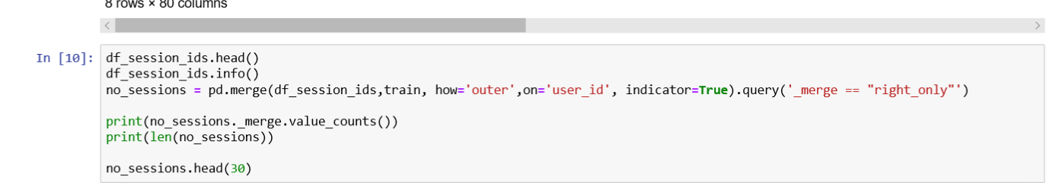
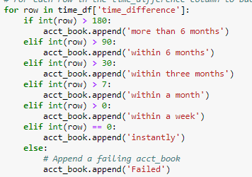
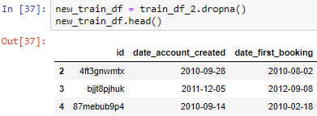
CONVERT NULLS TO 0 (CREATE NEW FIELDS FOR MODEL DEVELOPMENT)
MERGE PROCESSES ACROSS DATAFRAMES
DATA MANIPULATIONS
Notes:
Zineb -
Coding for Data Cleaning
+ Merged Dataframes

Slide 8
Exploratory Data Analyses
Notes:
Zineb –
There continue to be new Python and Tableau features and code to learn and utilize. The journey of learning has just begun.
Exploratory Data Analysis in Tableau enabled more efficient profiling and analyses.

Slide 9
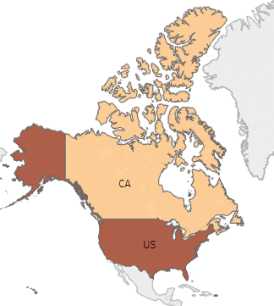
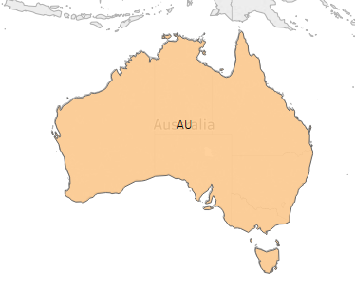
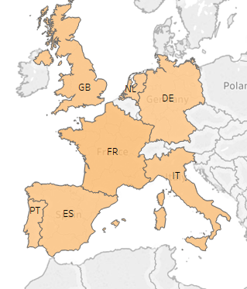

Countries Heatmaps
Notes:
Zineb –
First is this heatmap of the countries booked. And as you can see, the darker the color, the higher number of bookings in that country.
From this map, we can see that the US is the country with the highest number of bookings, followed by Western Europe then Canada.

Slide 10
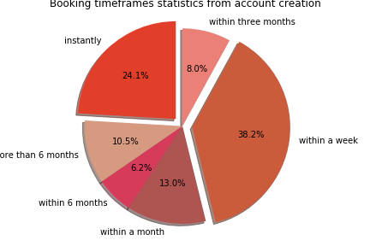
Bookings by Time from Account Creation
Notes:
Zineb –
Another major pattern we developed was the timeframe of account creation and bookings.
As we see here, the highest percentages of people who book from account creation is 38.2% and 24.1% (within a week and instantly).
So, a total of 62.3% booked in less than a week of account creation.

Slide 11
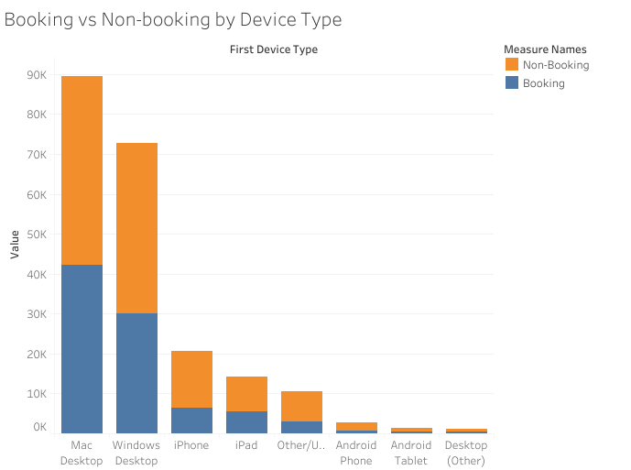
Devices Used in Booking vs Non-booking
Notes:
Zineb –
This graph shows the number of bookings by Device Type. We can see that the highest number of bookings we done through Mac Desktop and Windows Desktop. Whereas, the least number of bookings were done through Tablets and Smart Phones.

Slide 12
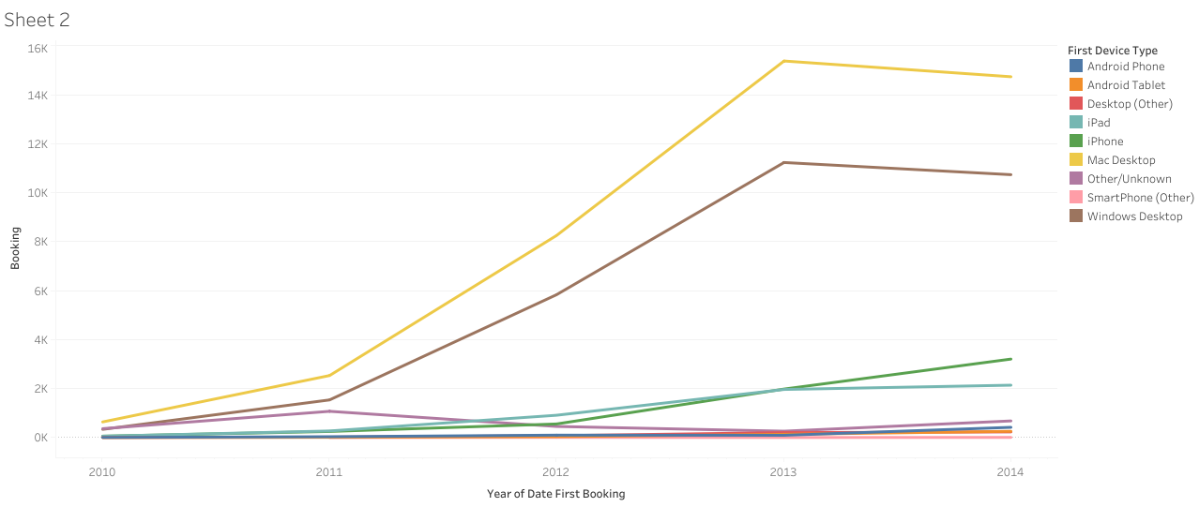
Devices Used in Bookings over the Years
Notes:
Zineb –
This graph emphasizes the previous graph’s conclusion and it shows the progress of booking devices by year. In addition to the Mac Desktop and Windows Desktop having the highest booking numbers and progress. We also see a pattern of gradual increase of iPhone usage for booking. Which makes sense as this dataset is during the timeframe of 2010 through early 2015, which is when smartphones were becoming more popular.

Slide 13
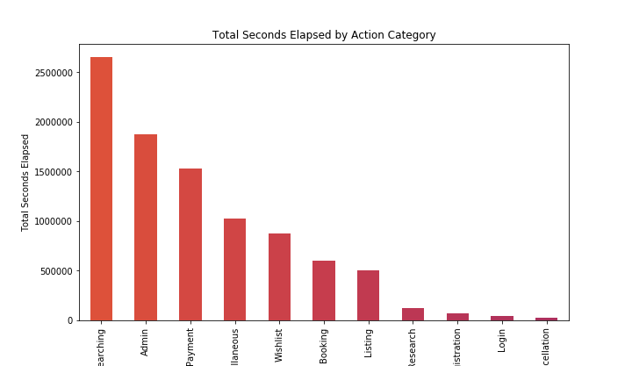
Total Seconds Elapsed by Action Category
Notes:
Juan

Slide 14
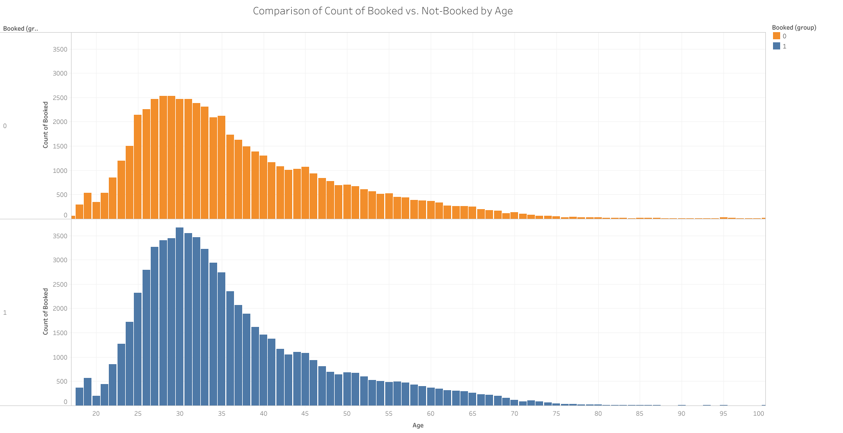
Booked vs. Non-booked Trips by Age
Notes:
Tanique?

Slide 15
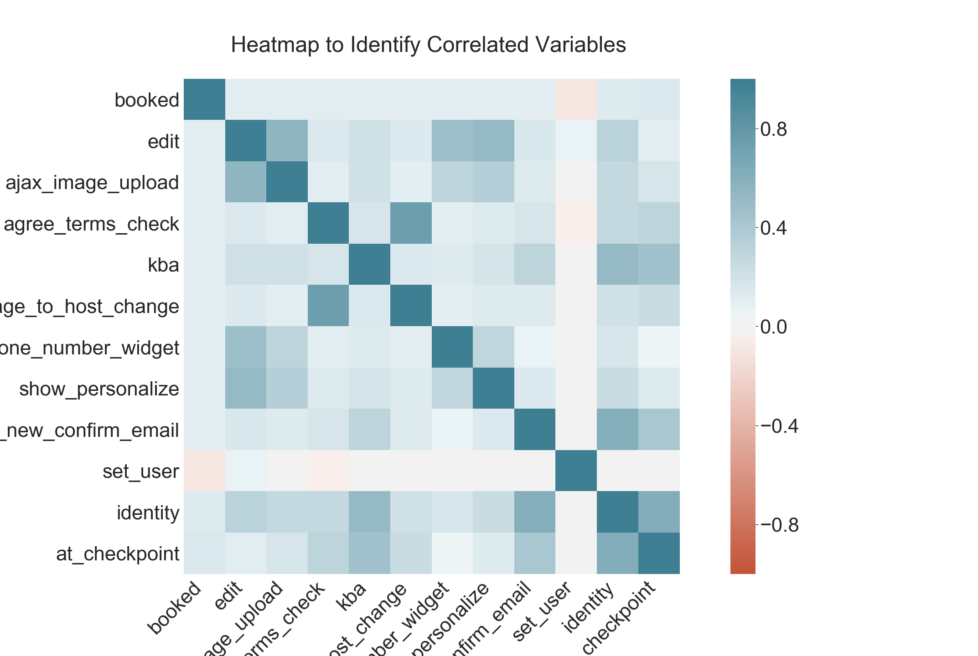
Correlated Variables Heatmap
Correlated variables (.5 or more) were removed from model
Notes:
Dee

Slide 16
MODELS
Notes:
Dee?

Slide 17
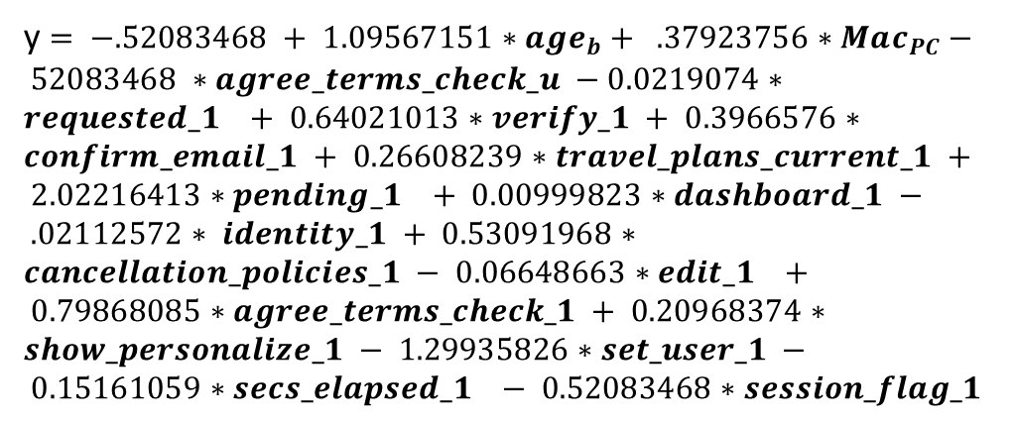
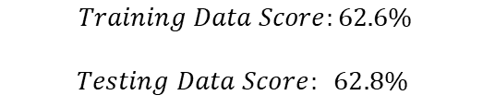
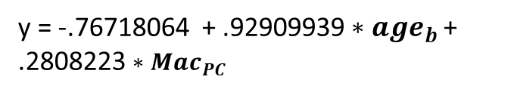
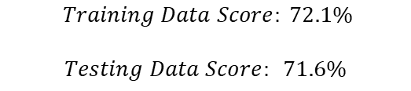
Resulting Logistic Model Equations
The business decision was to build two models: 1) a model when a User has session data and 2) a model when a User doesn’t have session data.
WITH SESSION DATA
y $= −.52083468 + 1.09567151∗age_{b}+ .37923756∗Mac_{PC}− 52083468 ∗agree_terms_check_u −0.0219074∗requested_1 + 0.64021013∗verify_1 + 0.3966576∗confirm_email_1 + 0.26608239∗travel_plans_current_1 + 2.02216413∗pending_1 + 0.00999823∗dashboard_1 − .02112572∗ identity_1 + 0.53091968∗cancellation_policies_1 − 0.06648663∗edit_1 + 0.79868085∗agree_terms_check_1 + 0.20968374∗show_personalize_1 − 1.29935826∗set_user_1 − 0.15161059∗secs_elapsed_1 − 0.52083468∗session_flag_1$
WITHOUT SESSION DATA
y = -.76718064 + .92909939 $∗age_{b}$+ .2808223 $∗Mac_{PC}$
$$Training Data Score: 72.1\%$$
$$Testing Data Score: 71.6\%$$
$$Training Data Score:62.6\%$$
$$Testing Data Score: 62.8\%$$
Notes:
Dee

Slide 18
Multinomial Logistic Regression
Independent Variables:
Gender
Age
Device Type
Desktop, Tablet, Phone
Action Count
Total actions taken by each user.
Usage Time
Total time user spent on website.
Outcomes: Country Destination
Australia
Canada
Germany
Spain
France
Great Britain
Italy
Netherlands
Portugal
United States
Other
Undefined
Notes:
Juan

Slide 19
Multinomial Logistic Regression Output
 | One vs Rest | One vs One
Train | 80.77% | 88.13%
Test | 80.77% | 88.13%
Null | 61.02% | 61.02%
Methods Used
One vs One Classification
One vs Rest Classification
Notes:
Juan

Slide 20
One vs Rest Method
Outcome | Correct Predictions | Total Instance | Accuracy Per Outcome
NDF | 16,114 | 18,016 | 89.4%
US | 7,936 | 8,038 | 98.7%
other | - | 1,462 | 0.0%
AU | - | 61 | 0.0%
IT | - | 392 | 0.0%
GB | - | 292 | 0.0%
FR | 6 | 574 | 1.0%
CA | - | 176 | 0.0%
ES | - | 283 | 0.0%
DE | - | 100 | 0.0%
NL | - | 99 | 0.0%
PT | - | 33 | 0.0%
True Negatives | 0 | 0 | 0 | 0 | 1 | 0 | 0 | 0 | 0 | 0 | 60 | 0 | False Positives
 | 0 | 0 | 0 | 0 | 2 | 0 | 0 | 0 | 0 | 0 | 174 | 0
 | 0 | 0 | 0 | 0 | 0 | 0 | 0 | 0 | 0 | 0 | 100 | 0
 | 0 | 0 | 3 | 0 | 1 | 1 | 0 | 0 | 0 | 0 | 278 | 0
 | 0 | 0 | 2 | 0 | 6 | 3 | 0 | 0 | 6 | 0 | 557 | 0
 | 0 | 0 | 2 | 0 | 2 | 0 | 0 | 0 | 1 | 0 | 287 | 0
 | 0 | 0 | 3 | 0 | 6 | 1 | 0 | 0 | 0 | 0 | 382 | 0
 | 0 | 0 | 0 | 0 | 14 | 0 | 0 | 16114 | 0 | 0 | 1888 | 0
 | 0 | 0 | 0 | 0 | 0 | 0 | 0 | 0 | 0 | 0 | 99 | 0
 | 0 | 0 | 2 | 0 | 0 | 0 | 0 | 0 | 0 | 0 | 31 | 0
 | 0 | 0 | 41 | 0 | 35 | 13 | 0 | 0 | 13 | 0 | 7936 | 0
False Negatives | 0 | 0 | 16 | 0 | 14 | 3 | 0 | 0 | 4 | 0 | 1425 | 0 | True Positives
Notes:
Juan

Slide 21
One vs One Method
Outcome | Correct Predictions | Total Instance | Accuracy Per Outcome
NDF | 18,016 | 18,016 | 100.00%
US | 3,916 | 8,038 | 48.72%
other | 766 | 1,462 | 52.39%
AU | - | 61 | 0.00%
IT | - | 392 | 0.00%
GB | - | 292 | 0.00%
FR | - | 574 | 0.00%
CA | - | 176 | 0.00%
ES | - | 283 | 0.00%
DE | - | 100 | 0.00%
NL | - | 99 | 0.00%
PT | - | 33 | 0.00%
True Negatives | 0 | 0 | 0 | 0 | 0 | 0 | 0 | 0 | 0 | 0 | 33 | 28 | False Positives
 | 0 | 0 | 0 | 0 | 0 | 0 | 0 | 0 | 0 | 0 | 94 | 82
 | 0 | 0 | 0 | 0 | 0 | 0 | 0 | 0 | 0 | 0 | 42 | 58
 | 0 | 0 | 0 | 0 | 0 | 0 | 0 | 0 | 0 | 0 | 153 | 130
 | 0 | 0 | 0 | 0 | 0 | 0 | 0 | 0 | 0 | 0 | 311 | 263
 | 1 | 0 | 0 | 0 | 0 | 0 | 0 | 0 | 0 | 0 | 162 | 129
 | 0 | 0 | 0 | 0 | 0 | 0 | 0 | 0 | 0 | 0 | 219 | 173
 | 0 | 0 | 0 | 0 | 0 | 0 | 0 | 18016 | 0 | 0 | 0 | 0
 | 0 | 0 | 0 | 0 | 0 | 0 | 0 | 0 | 0 | 0 | 38 | 61
 | 0 | 0 | 0 | 0 | 0 | 0 | 0 | 0 | 0 | 0 | 16 | 17
 | 4 | 0 | 0 | 0 | 1 | 0 | 0 | 0 | 0 | 0 | 3916 | 4117
False Negatives | 0 | 0 | 0 | 1 | 0 | 0 | 0 | 0 | 0 | 0 | 695 | 766 | True Positives
Notes:
Juan

Slide 22
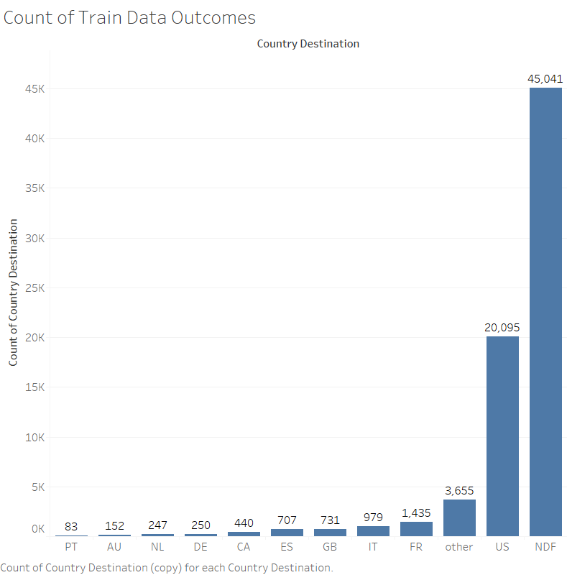
Results
Although Accuracy is high model is not accurate across all outcomes.
Sample data is not evenly distributed.
Additional work is needed to increase accuracy.
Adjust data sampled
Remove Correlated Values
Explore alternate models
Notes:
Juan

Slide 23
RESULTS & LEARNINGS
Notes:
Dee

Slide 24

MAJOR FINDINGS
Most users who book a trip, create an account in less than 2 weeks and vise versa.
Most trips booked are from the US.
Business problems that are tasked with being solved with machine learning do not always imply inherent success or result in high predictability.
There continue to be new Python and Tableau features and code to learn and utilize. The journey of learning has just begun.
Exploratory Data Analysis in Tableau enabled more efficient profiling and analyses.
Notes:
Dee

Slide 25

THANK YOU !

